Slide 1
Applications of Artificial Intelligence and Machine Learning
Solomon Awuku
DeVry ,June 2024

Slide 2
Introduction
The objective of this project is to develop a linear regression model to predict consumer reports ratings of cereals based on various features such as nutritional content and manufacturer information. The dataset used for this project contains data on 77 different cereals, including features like calories, protein, fat, sodium, fiber, carbohydrates, sugars, potassium, vitamins, and more.

Slide 3
Uploading Dataset
The dataset, cereal.csv, was uploaded to Azure Machine Learning Studio. This file was sourced from Kaggle and contains comprehensive data on various cereals, including their nutritional values and ratings.

Slide 4
Data Used

Slide 5
Cleaning the Data
The dataset was examined for missing values. Since there were no missing values in the dataset, no imputation was necessary.

Slide 6
Cleaned Data

Slide 7
Normalizing Data
Numerical columns were normalized to ensure they are on a similar scale, which helps improve the performance of the machine learning model. The columns normalized include calories, protein, fat , sodium, fiber, carbo, sugars, potassium, vitamins, weight, cups

Slide 8
Normalized Data

Slide 9
Editing Metadata .
The metadata for the columns mfr, type, and shelf were updated to categorical data types to ensure proper handling during the modeling process

Slide 10
Data Edited

Slide 11
Data Visualization
To understand the relationships between the features, a pairwise scatter plot was generated. This helped in identifying potential correlations and the importance of each feature in predicting the cereal ratings

Slide 12
Scatted Plot

Slide 13
Feature Selection
Based on the visualizations and domain knowledge, the following columns were selected for the model:
Mfr, type, calories, protein, fat, sodium, fiber, carbo, sugars, potassium, vitamins, shelf, weight, cups, rating (target variable)

Slide 14
Result Dataset

Slide 15
Transition
Moving from Algorithm Selection to Model Evaluation

Slide 16
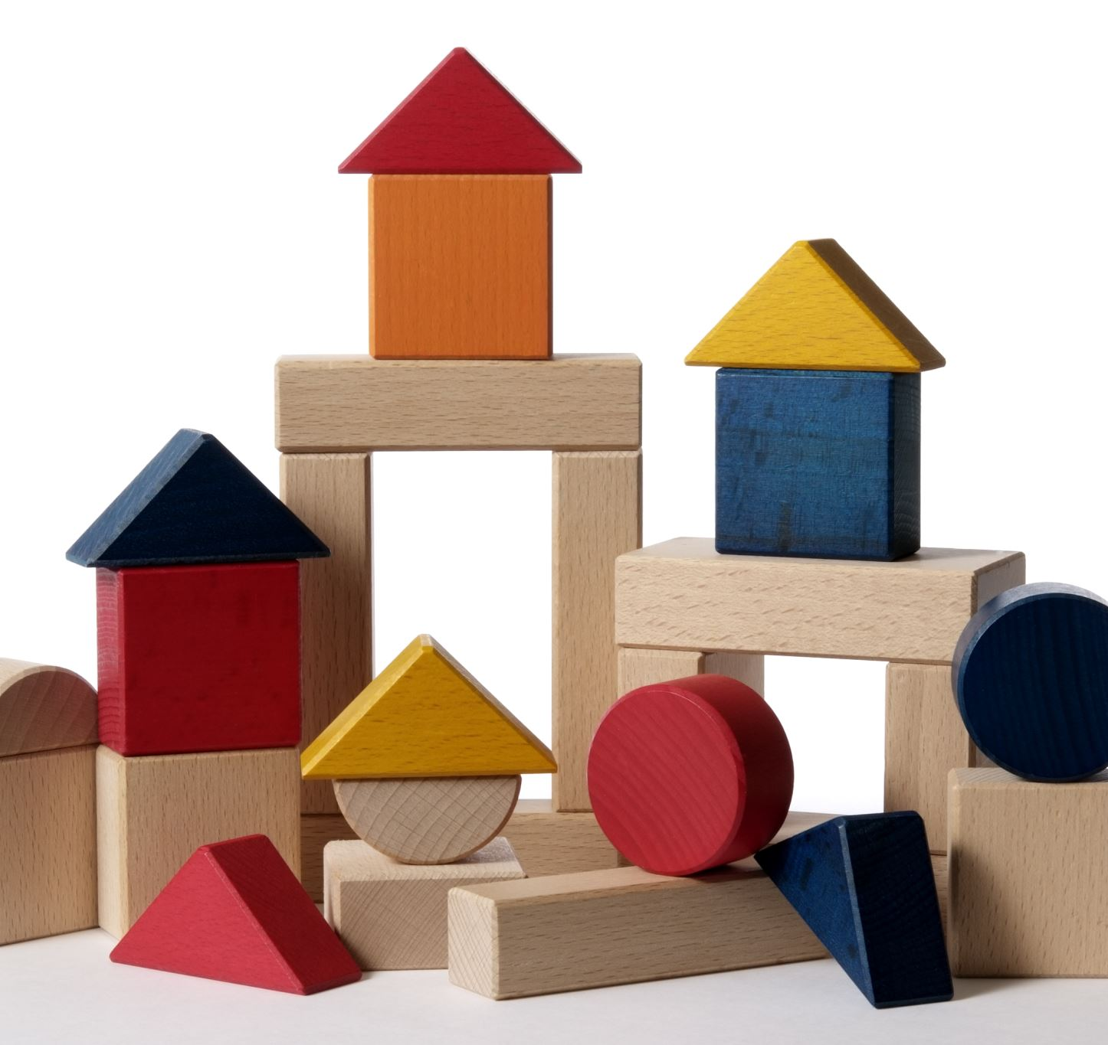
Splitting Data
The dataset was split into training (70%) and testing (30%) sets to ensure that the model could be evaluated on unseen data.

Slide 17
Split Data

Slide 18
Linear Regression Model
A linear regression model was chosen for this project due to its simplicity and effectiveness in predicting continuous outcomes. The target variable for this model was rating.

Slide 19
Screenshot

Slide 20
Training the Model
The training set was used to train the linear regression model. The model was configured to predict the rating of cereals based on the selected features

Slide 21
Trained Model

Slide 22
Scoring the Model
The trained model was then used to score the testing set. This step involved predicting the ratings for the cereals in the testing set and comparing them to the actual ratings

Slide 23
Scored Data

Slide 24
Evaluating the Model
The performance of the model was evaluated using the R² value and other metrics. The initial evaluation showed an R² value of 0.83, indicating a good fit.

Slide 25
Evaluation Results

Slide 26
Iteration Process 1
Changes: Removed less influential features cup ,shelf and weight .
Reason: Initial analysis showed low correlation with the target variable.
Impact: R² value improve to 0.72.

Slide 27
Iteration Process 2
Changes: Focused on key nutritional features and excluded type.
Reason: Nutritional content is more directly related to consumer ratings.
Impact: R² value improved to 0.83.

Slide 28
Conclusion
The final model achieved an R² value of 0.83, indicating a good fit and a reliable prediction of cereal ratings based on the selected features. The most influential features included sugars, fiber, and protein content.

Slide 29
Challenges
Several challenges were faced during this project:
Handling categorical data effectively.
Identifying the most impactful features through iterations.
Balancing model complexity and interpretability

Slide 30
Career Skills
Through this project, valuable skills were gained:
Data preprocessing and normalization techniques.
Feature selection and engineering.
Model training, evaluation, and iteration in Azure Machine Learning.
Interpretation and communication of machine learning results.

