Slide 1
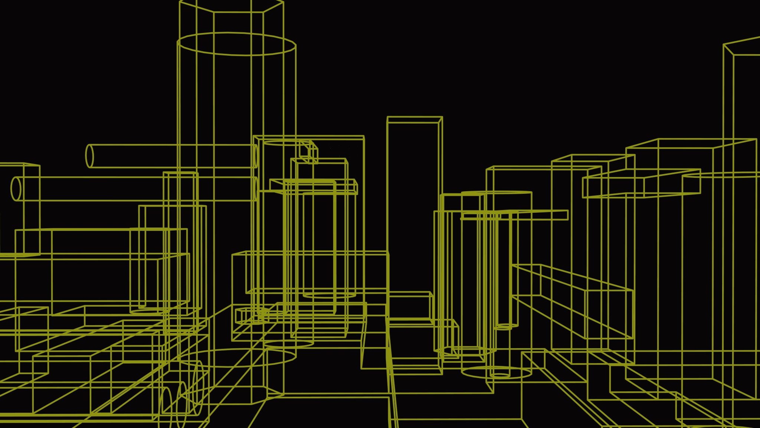
CIS355A
Business Application Programming
Solomon Awuku

Slide 2
Introduction
Java is a popular high-level programming language for its portability, versatility and robustness
Java widely used for variety of applications , including web development, mobile app development enterprise applications and more
Java ecosystem includes rich libraries , tools and frameworks that simplify java application development. Eg IntelliJ IDEA, Eclipse and NetBeans.
Java can read and write to files and provide simple connection to databases

Slide 3
Project Inventory

Slide 4
Design Phase
During the design phase all stakeholders collaborate to define the project requirement . This ensures that everyone has a clear understanding of the project goals and objective, saving time.
Wireframe diagrams gives us a target to achieve and a roadmap for implementing the application.
UML Class diagram provides structure for the application

Slide 5
Wireframe Diagram
GUI design
Layout for the user interface
Components to be used

Slide 6
UML Class Diagram
Classes to used
Structure for our objects
Overall structure for application

Slide 7
GUI Application
Started a simple Gui application
Implemented labels and text fields
Generated the frame
Centered the application

Slide 8
Simple GUI
Labels – shows info
Text fields – Gets user inputs
Buttons - produce events
Event handlers – runs code base on event

Slide 9
Event Code
Code divided into methods
Write once, run everywhere!
Pull inputs from text fields
Process inputs
Show desired output

Slide 10
Advance GUI
Create a GUI that uses Checkbox, RadioButton, Text Area, and menus.
Process multiple events.
Text Area to display the receipt
Create a menu with the following options, File, Order and Exit
Clear for next item

Slide 11
Advance GUI
RadioButton to choose between grass and gravel
Checkbox for add on
Menu bar

Slide 12
Code

Slide 13
Processing Arrays of Objects
Create a GUI that uses List and Tabbed Panes.
Process multiple objects in an Array List.
Code event handlers for multiple events.
ArrayLists are resizable arrays.
List contains a DefaultListModel, which is similar to an ArrayList .
Use the DefaultListModel to add and remove from a list.
Tabbed Panes allow us to organize our application.

Slide 14
Advance GUI with Tabs
Create a default and parameterized constructor.
Create sets and gets for all instance variables.
Create a get method
Add Tabs to GUI application
Add List to GUI application
Use Array List to process object arrays

Slide 15
Code

Slide 16
Read and Write to Files
Add persistent data storage using text file input and output.
Write data from the GUI to a file.
Read data from the file and display the data on the GUI application.
Use a three-tier architecture to handle large development projects.

Slide 17
GUI
GUI classes read info from the user and displays info to the user.
The GUI classes should do all of the communication with the user
Data storage use a separate class to read and write to the file or database

Slide 18
Code
We need to create the DataIO class.
Let’s create the add( ) method so we can write the Customer object to the file.
Customer objects

Slide 19
Database Connectivity
Before we can read or write to a database, we need to have the database driver in the root folder of our project
Access to MySQL database to add and display records
Create new schema and a Table in the connected server
Check for the database driver.
Connect to the database.
Add the Customer record to the Table

Slide 20
Database with Cust Info

Slide 21
GUI
Gui displaying customer information stored in database

Slide 22
Code

Slide 23
Challenges
Code is sensitive
Debugging skills required
Difficulties installing NetBeans
Connectivity to database was challenging

Slide 24
Career Skills
Using three-tier development
Designing GUI application with Java
Debugging applications skills
Using java syntax
Designing classes with UML
Wireframe GUI designing

Slide 25
Conclusion
Java's design incorporates key object-oriented principles which result in a language that supports the creation of well-structured, reusable, and easily maintainable code. This object-oriented approach ensures that Java developers can tackle complex problems with a methodology that encourages cleaner, more logical design patterns. With its capability to run on any platform without the need for recompilation (write once, run anywhere), Java stands out as a highly versatile choice for developing diverse applications, ranging from the web and mobile domains to large-scale enterprise systems. The robust and comprehensive ecosystem of Java, filled with an extensive array of libraries and tools, allows for rapid development and integration of new features and functionalities. The vibrant global community not only contributes to this ecosystem but also offers a supportive network for developers, providing a wealth of knowledge, continuous learning opportunities, and collaborative problem-solving. All these elements combine to make Java not just a programming language but a powerful environment for innovation and development in the modern technological landscape.

Slide 26
Thank you

