Slide 1
INTERMEDIATE PROGRAMMING
CEIS 209
Solomon Awuku

Slide 2
INTRODUCTION
This project explores structured and object-oriented program development.
Then we will use language syntax, selection and iteration control structures, functions, debugger tools and techniques, objects, classes, encapsulation, polymorphism and inheritance to create a program that requires decision and iteration, implements functions, uses arrays and define classes.
The program will utilize inheritance and introduces abstract classes.

Slide 3
SOFTWARE
C# programming language is used
Visual Studio

Slide 4
SOFTWARE ENVIRONMENT SETUP

Slide 5
CREAT A WINDOWS FORM APPLICATION WITH BASIC CONTROL
After setting up the environment we create a windows form with basic controls

Slide 6
FORM WITH BASIC CONTROLS
We will create a new form in visual studio that will have basic controls . TITLE , ARTIST, GENRE, YEAR , and URL.
We will also add the button called “ Add Song” to our form to be able to add new songs to our program.
We will also add an event listener for the “Add Song “button called “AddsongButton_click”

Slide 7
SCREENSHOT OF PROGRAM RUNNING

Slide 8
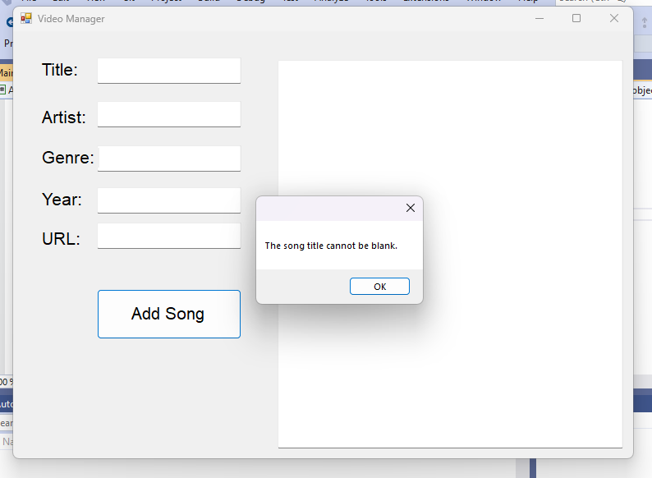
VALIDATING INPUT FROM FORM
Use IF statements to determine if textboxes are empty
Use MessageBox.Show to display error/success messages

Slide 9
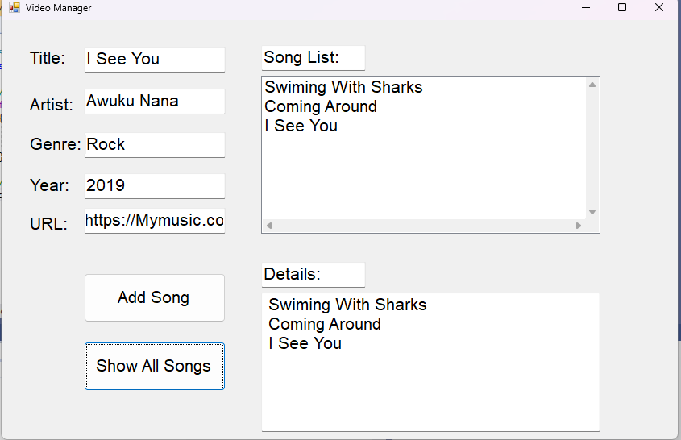
SCREENSHOT OF PROGRAM RUNNING

Slide 10
ADDING EVENT HANDLERS TO CONTROL AND WRITING UTILITY METHODS
Create a method (a function in this case) to return true if the user entered non-empty input for the “Add Song” button, or false if the input is empty
Create a method (another function) to return true if a song title is found, or false if it is not found
Use string.contains to determine if a song title is contained in the text of a List box
Activate tabbing from one control to another
Create individual one-dimensional arrays for each feature of a song

Slide 11
SCREENSHOT OF PROGRAM RUNNING

Slide 12
CREATING AND USING CLASSES AND OBJECTS
Design and create two Windows forms with GUI controls
Create an employee class to encapsulate employee information
We will create a windows forms application with basic controls and add an Employee Class

Slide 13
SCREENSHOT OF PROGRAM RUNNING

Slide 14
ENCAPSULATING DATA AND WRITING TO FILE
We will use the Employee class to encapsulate the employee information to make the application maintainable so that when users click the AddButton it will get information for the employee, create an employee object and add the employee object to the employees ListBox.
Finally, we will save all the employee information to file

Slide 15
SCREENSHOT OF PROGRAM RUNNING

Slide 16
USING COMPOSITION
After we have created the employee class to encapsulate the employee information , we will create a Benefit class that will also encapsulate benefit information for each employee. So that when we have an employee object open, we can simply open that Employee object’s Benefit object. This is called composition
We will then create the benefit attributes to go with the Benefit class

Slide 17
SCREENSHOT OF PROGRAM RUNNING

Slide 18
INHERITANCE AND POLYMORPHISM
We will use inheritance so we can pay different employee types without having to rewrite all the attributes and methods.
Create Salary Class to inherit from the Employee Class ,then add annualSalary attribute to the Salary class.
Create an Hourly Class that will also inherit from the Employee Class and add hourlyWorked and hourlyRate attributes to the Hourly Class created.

Slide 19
SCREENSHOT OF PROGRAM RUNNING

Slide 20
CHARLLENGES
When creating a C# program, it needs to be in the same directory
Case sensitivity makes C# difficult like other major programming languages
Coding in C# , synthax errors and debugging
Misspelling and misuse of C# functions

Slide 21
CARRER SKILS
Explain the concept of object-Oriented Programming
Build an application program using C#
Develop program using classes, inheritance and polymorphism
Understanding and developing program using C# libraries

Slide 22
CONCLUTION
This project covered intermediate topics of programming with objects by using C# programming language in visual studios
Creating this application provided a hands-on learning opportunity to put into practice the topics covered in this course.

Slide 23
Thank You
solomonawuku@gmail.com

