Slide 1
PHYS204
Physics Fundamentals Laws of Mechanics
Solomon Awuku

Slide 2
Introduction
This course project is based on the scientific method and is divided into six parts. Each deliverable builds from the previous resulting in a full scientific experiment.
The development process of the project includes critical thinking, hardware setup, programming, and data analysis.
It will encompass the several aspects of the IoT and prepare you for your future career in technology.
It covers precision, free-fall, rotational motion, and hall effect

Slide 3
Project Overview
Part 1: Project Inventory
Part 2: Determine the Precision of the Ultrasonic Sensor
Part 3: Find the Gravitational Acceleration of a Free-falling Object Using the Ultrasonic Sensor
Part 4: Analyze Conservation of Energy from Ultrasonic Sensor
Part 5: Convert Radial Displacement to Linear Displacement Using the Rotary Encoder
Part 6: Observe the Hall Effect

Slide 4
Part 1
In this part of the project, we gather all the necessary items the we would use in the entire project and the software used
Project Inventory

Slide 5
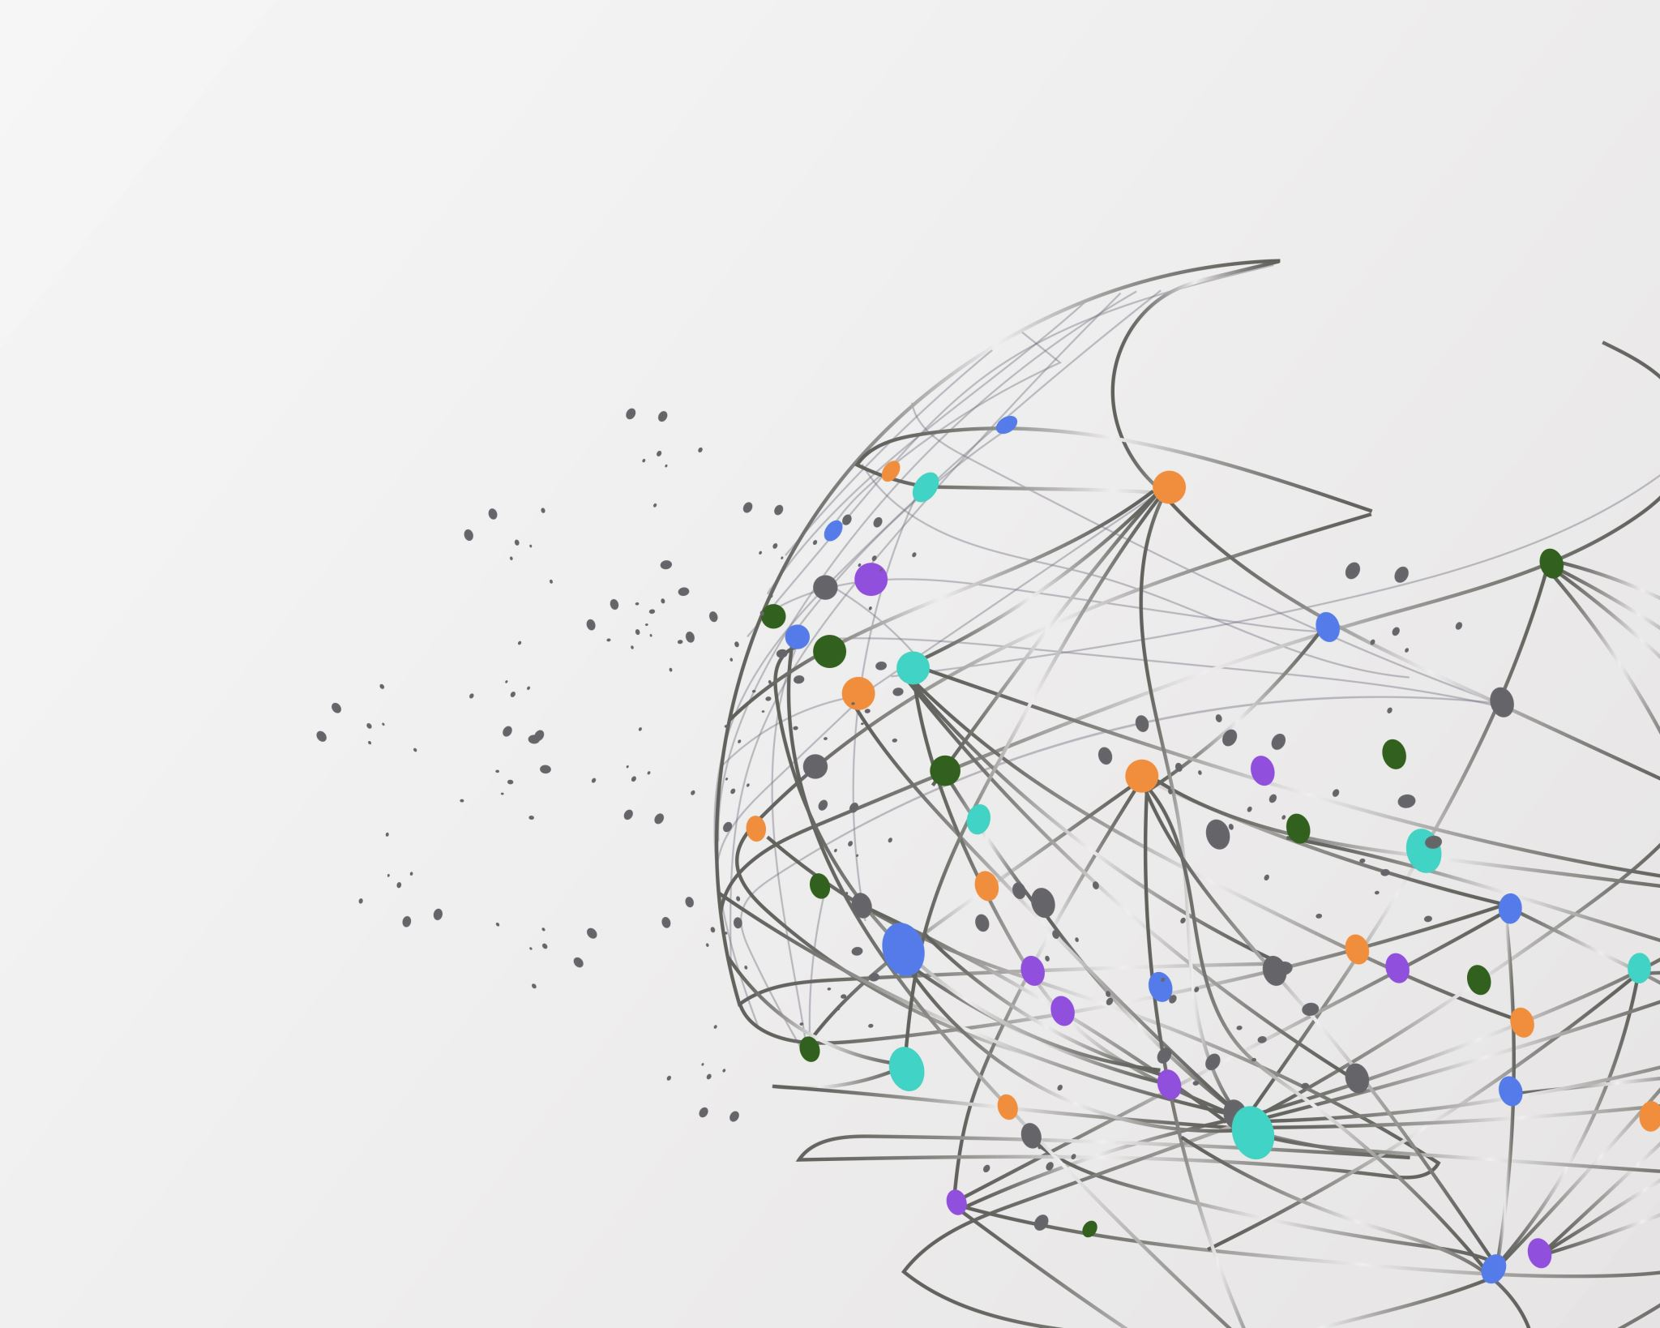
Software Used
Arduino IDE
Excel

Slide 6
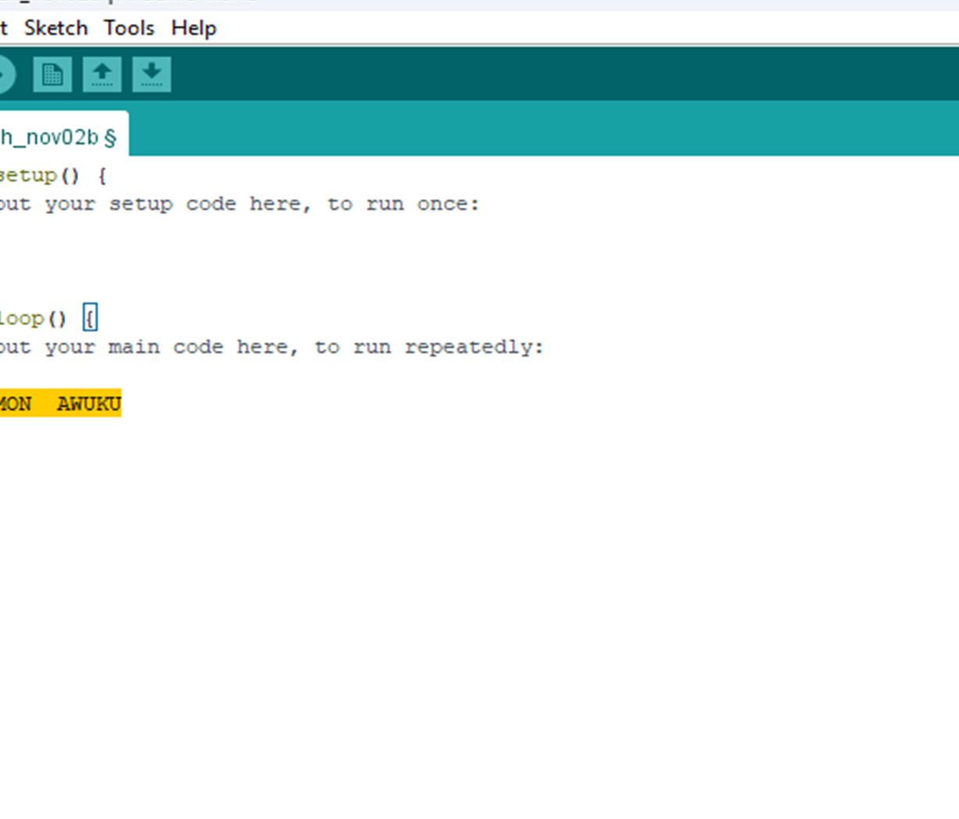
SOFTWARE ENVIRONMENT SETUP
Setting up Arduino ide environment for project.

Slide 7
Inventory 1
Arduino Mega 2560
Ultrasonic sensor HC-SR04
Male to Male Wires
Breadboard
USB cable to connect Arduino
Ruler or tape measurer
Object to act as obstacle and/or undergo free-fall

Slide 8
Inventory 2
Arduino Mega 2560
Rotary Encoder Part KY-040
Male to Female Wires
USB cable to connect Arduino
Object to attach onto rotary encoder
Ruler or tape measurer

Slide 9
Inventory 3
ESP32 microprocessor
Micro-USB cable
Magnet

Slide 10
Precision of the Ultrasonic Sensor
The ultrasonic sensor is an electric device with two conductors that are used to detect an object within its range. Determining the precision of the data gathering sensor is essential in experiment as sensors often drift over time and give incorrect results

Slide 11
Experimental Setup
Materials List:
Mega 2560 Board
Ultrasonic sensor HC-SR04
Male to Male Wires
Breadboard
Ruler or tape measurer
Large and flat object to act as obstacle

Slide 12
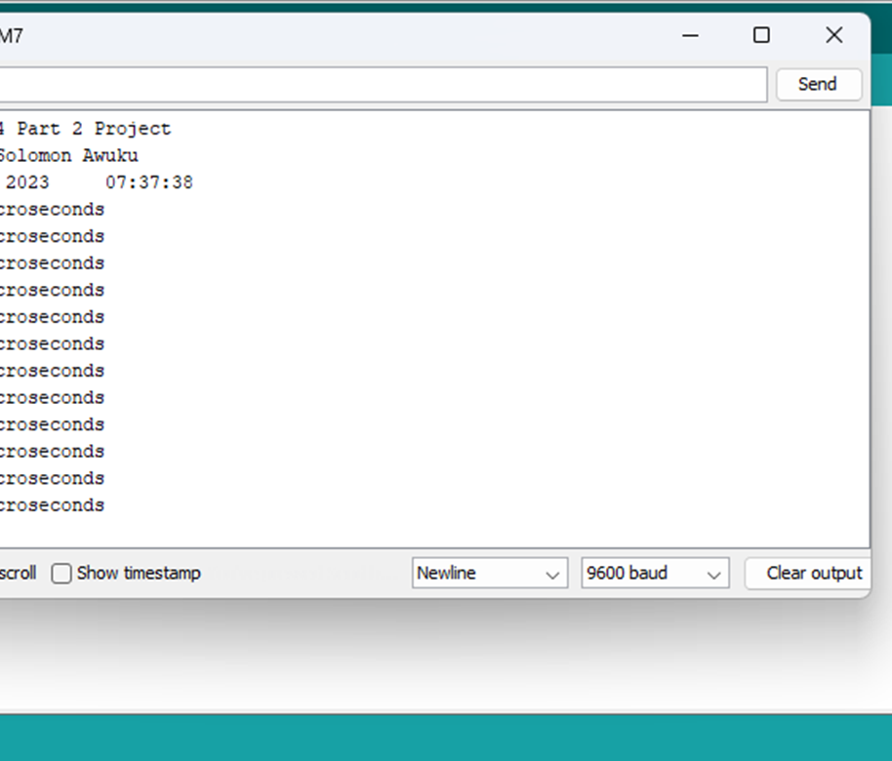
Raw Data

Slide 13
Data Collection

Slide 14
Data Analysis
Average velocity from table
Percent difference where $v_{sound}=343 m/s$
$$v_{avg}= \frac{v_{1}+v_{2}+v_{3}+v_{4}+v_{5}}{5}$$
351
m/s
$$Percent difference = \frac{\left|v_{avg}−v_{sound}\right|}{v_{sound}}×100$$
2.33
%

Slide 15
Conclusions
Discuss the results and comment on the source of errors.
Answer: Results was influenced by rounding of data, room temperature and sensor range.
What is the dependence of temperature, humidity, and atmospheric pressure on the speed of sound? How does it affect the results?
Answer: Temperature, humidity and atmospheric pressure affect the speed of sound significantly. When temperature increases the speed of sound increases and vice-versa. When humidity increases the speed of sound decreases because water vapor is lighter than dry air and its presence reduces the average molecules weight of the gas mixture and as atmospheric pressure increases the sound of speed increases.
These affect the results in calculating the speed of sound. To obtain a more accurate value of the speed of sound you must consider these factors because when chances it can altar the speed of sound, which in turn affect the behavior of sound waves .
Reference: HTTPs://ng.cengage.com/static/nb/ui/evo/index.html?eISBN=9780357107898&id=339300716&snapshotId=877145&

Slide 16
Gravitational Acceleration of a Free-falling Object Using the Ultrasonic Sensor
After the precision of the ultrasonic sensor has been determined, we use it to determine the gravitational acceleration of free-falling objects. This data will be used to investigate the conservation of energy during the fall of objects

Slide 17
Experimental Set-up
Materials List:
Mega 2560 Board
Ultrasonic sensor HC-SR04
Male to Male Wires
Breadboard
Large and flat object that is not susceptible to air resistance to undergo free fall motion

Slide 18
Serial Monitor
Include screenshot of raw data showing the start of the fall and end of the fall of one trial.

Slide 19
Excel Table
Include all values in the Excel table for a single trial showing the fall distance in centimeters and meters as a function of time
Be sure your drop your drop is long enough to experience free-fall.
A good drop is from a height of a table or countertop.

Slide 20
Excel Graph
Include Excel graph for a single trial showing the fall distance as a function of time.
Confirm that most data points fall along the curve fitting.
The x² coefficient should be between 2.5 and 7.5 such that its yields an acceleration value between 5 m/s² and 15 m/s²

Slide 21
Data Collection
Trial | x² coefficient value from curve fitting | Acceleration (m/s²) = 2* (x² coefficient)
1 | 3.85 | 7.7
2 | 3.98 | 7.96
3 | 4.88 | 9.76
4 | 4.42 | 8.84
5 | 4.51 | 9.02

Slide 22
Data Analysis
Average acceleration from table
Percent difference with $g=9.8 m/s^{2}$
$$a_{avg}= \frac{a_{1}+a_{2}+a_{3}+a_{4}+a_{5}}{5}$$
8.66
$${m/s}^{2}$$
$$Percent difference =\frac{\left|8.66−9.8\right|}{9.8}×100$$
11.63
%

Slide 23
Conclusions
Discuss the results and comment on the source of errors.
Answer: The sources of error are room temperature and movement of object in motion
How much variation is there from trial to trial? What does this indicate about the uncertainty of the result?
Answer: Higher variation means uncertainty of results and are likely not to be accurate but lower variation implies more precise and reliable the measurement.

Slide 24
Conservation of Energy from Ultrasonic Sensor
In this part, the free-fall data is used to observe the transformation of potential energy to kinetic energy. The total mechanic energy gives insight into the conservation of energy

Slide 25
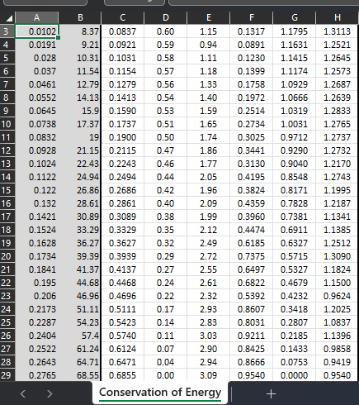
Excel Table
Include all values in the Excel table for a single trial showing the fall distance in centimeters and meters as a function of time with the values generated for kinetic energy K, potential energy U, and total mechanical energy E.

Slide 26
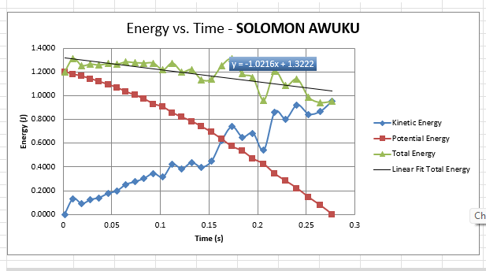
Excel Graph
Include Excel graph for a single trial showing the plots of the kinetic energy K, potential energy U, and total mechanical energy E as a function of time.

Slide 27
Data Analysis
Theoretical value of final velocity
Final velocity from experimental data (or largest velocity)
Percent difference
$h=y_{final}−y_{initial}=$
0.6018
m
$v_{f}=\sqrt{2gh}=$
3.43
m/s
$v_{experimental}$ =
3.09
m/s
$$Percent difference =\frac{\left|v_{f}−v_{experimental}\right|}{v_{f}}×100$$
9.9
%

Slide 28
Conclusions
Discuss the key characteristics of the plot. Consider the points when potential energy U is maximum, U is minimum, kinetic energy K is maximum, K is minimum and when U and K are the same value. What is the significance of these points?
Answer: When potential energy U is maximum, kinetic energy K is minimum and vice-versa. But when they are the same, it implies that energy is shared equally. At this point energy is conversed.

Slide 29
Circular Motion with Rotary Encoder
In this part of the project, we observe the relationship between radial displacement and linear displacement using rotary encoder

Slide 30
Experimental Set-up
Materials List:
Mega 2560 Board
Rotary Encoder Part KY-040
Male to Female Wires
Object to attach onto rotary encoder (e.g. cork, bottle cap, ball)
Ruler or tape measurer

Slide 31
Raw Data
Screenshot of Serial Monitor from Arduino IDE showing raw data.

Slide 32
Data Collection
Object diameter: d =
Object radius: r =
Number of pulses for one revolution: x =
Resolution = $\left(\frac{1 }{x } \frac{Revolution}{pulses}\right)∙\left(\frac{2∙π radians}{1 Revolution}\right)=$
4.5
cm
2.25
cm
30
0.209
Radian/Pulse

Slide 33
Data Analysis
Trial | Number of pulses N | Encoder distance r$∙Resolution∙$ N | Measured distance with ruler | Percent difference
1 | 16 | 2.25*0.209* 16 = 7.52cm | 8cm | 6%
2 | 20 | 2.25*0.209* 20 = 9.405 | 10 | 5.95%
3 | 25 | 2.25*0.209* 25 = 11.75 | 12 | 2.08%
4 | 30 | 2.25*0.209 *30 = 14.10 | 14 | 0.71%
5 | 34 | 2.25*0.209*34 = 15.98 | 16 | 0.13%

Slide 34
Conclusions
Discuss the results and comment on the sources of error.
Answer: Error in measurement, pressure on encoder not enough
Table surface to slippery
Attached object shinny on the surface.
What are some applications of this measuring technique? Could this measuring system be used to measure surfaces that are not flat?
Answer: Odometer, Coordinated Measuring Machine (CMMs), Laser Tracker
These applications can be used to measure surfaces that are not flat.

Slide 35
Hall Effect
In this part of the project, investigation of the hall effect is conducted using the ESP32 microcontroller to measure the proportional voltage under the effect of a magnetic field. The hall effect sensor is located behind the metal lid of the ESP32 chip. Measurement from the sensor can increase or become negative depending on the magnet pole facing the sensor

Slide 36
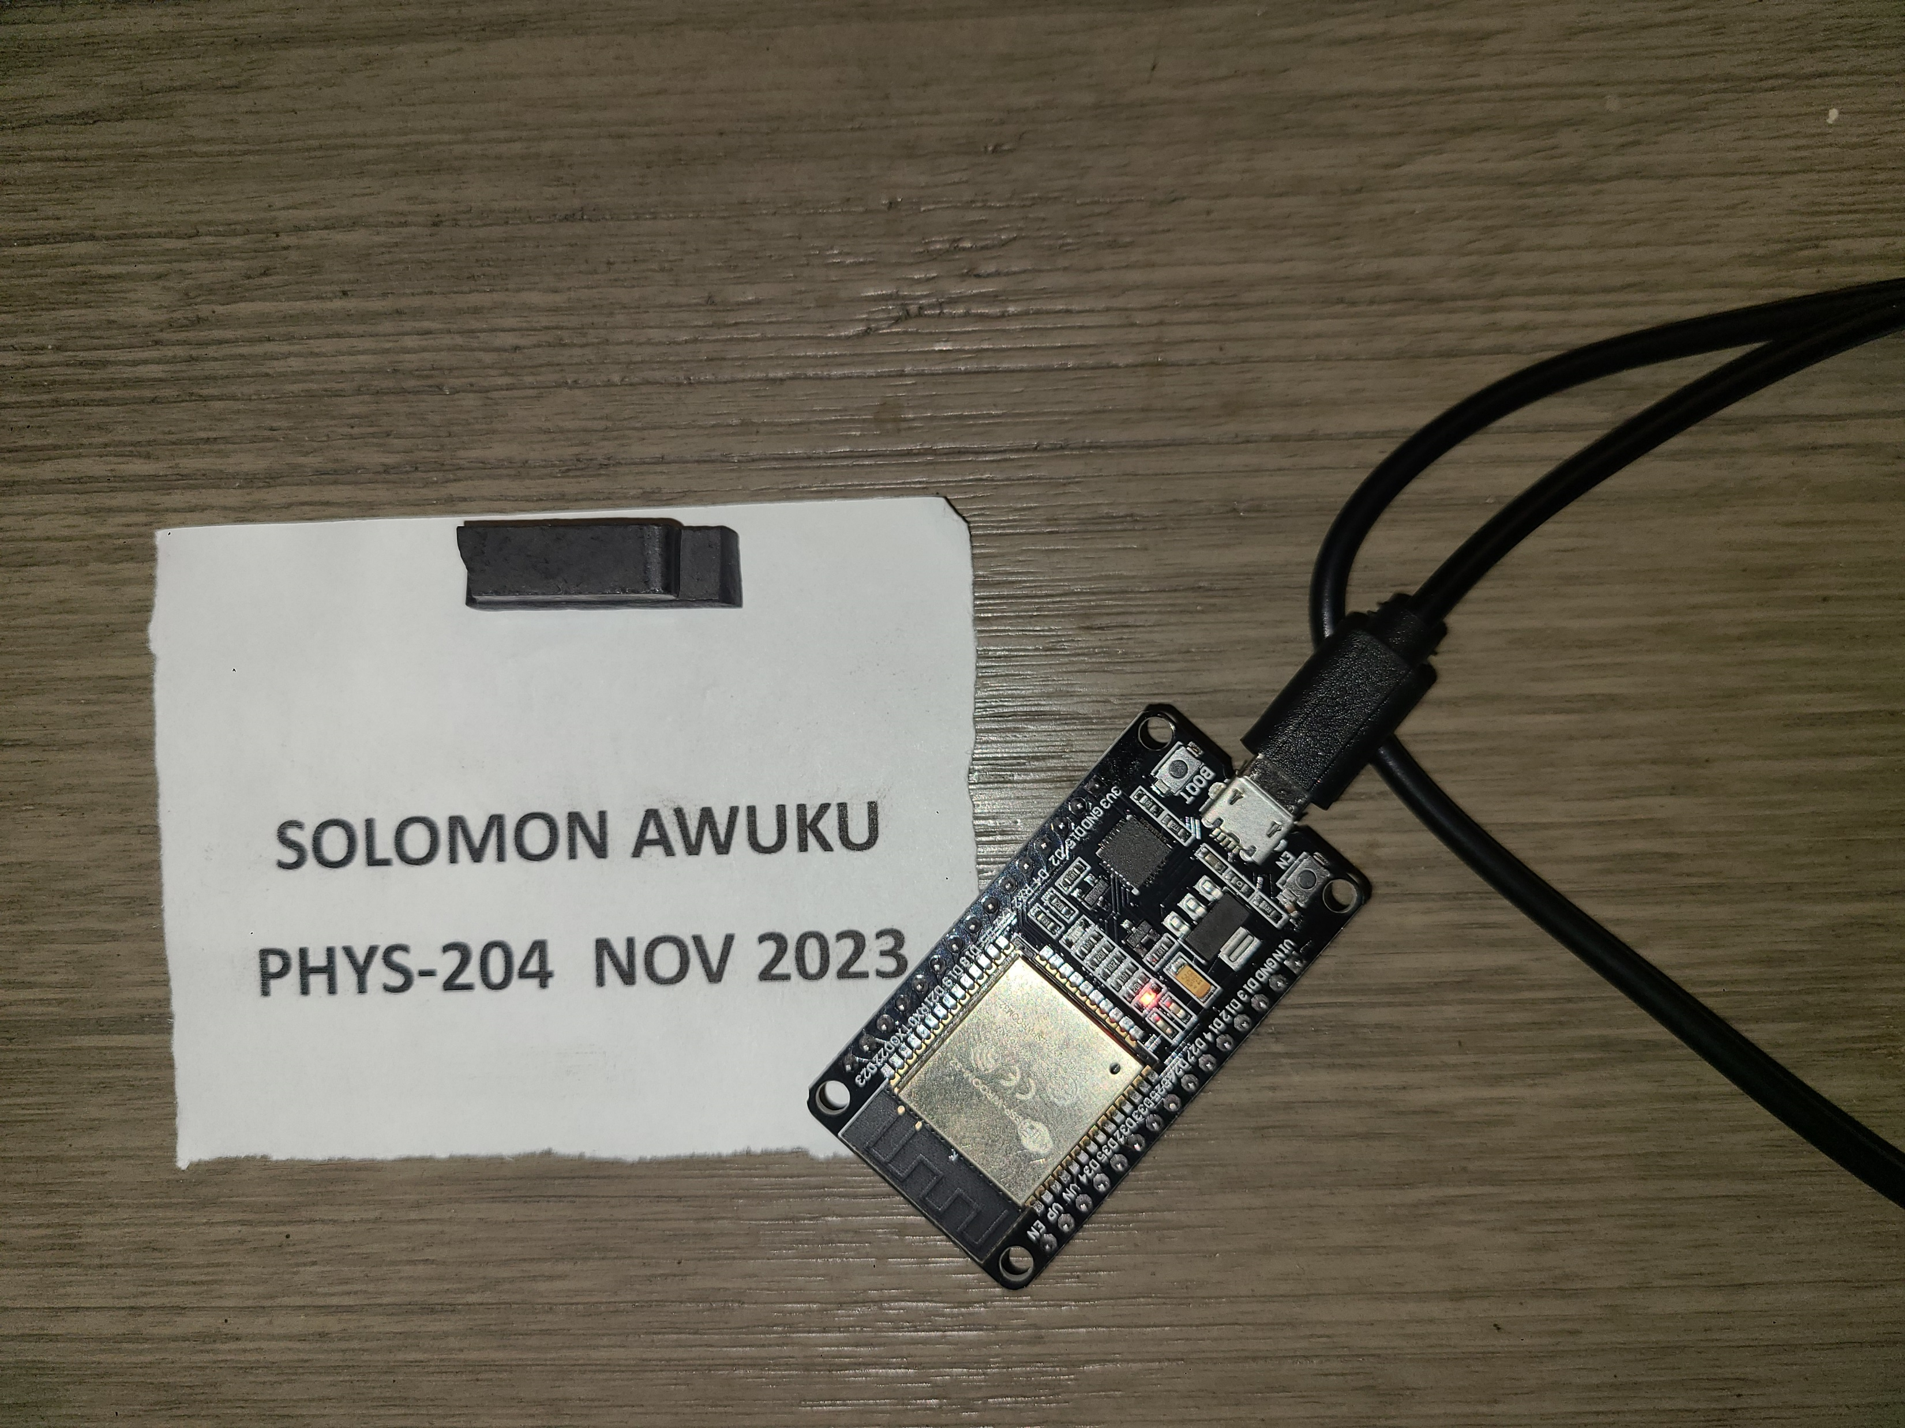
Experimental Set-up
Materials List:
ESP32 microprocessor
Micro-USB cable
Magnet

Slide 37
Raw Data
Screenshot of Serial Monitor from Arduino IDE showing raw data.
Must include your name displayed in the Serial Monitor.
Press EN button to display name.
Unselect “Autoscroll” and scroll all the way up.

Slide 38
Excel Graph
Include Excel graph for a single trial of data plotted as a function of time.
Must include your name in the title of the graph.

Slide 39
Conclusions
Describe how the Hall sensor works. What are some applications for the Hall effect sensor?
Answer: Hall sensors are versatile devices that can detect the presence, strength, and polarity of magnetic fields. When magnetic field is applied perpendicular to the current flow in the semiconductor material, it causes the charge carriers to be deflected to one side of the conductor. This creates a measurable difference across the semiconductor.
Some application for the hall effect sensor are .position sensor, speed sensor, brushless DC motors and proximity sensors.

Slide 40
Challenge
This project requires differences sensors and hardware knowledge
The free fall motion reveals that objects drifts and requires smaller time increments
Software setup can be difficult as the right setup is needed for accurate reading

Slide 41
Career Skills
The development process of the project includes critical thinking, hardware setup, programming, and data analysis.
Project encompass the several aspects of the IoT and prepare you for your future career in technology

Slide 42
Conclusion
This project utilized household items and simple experiments to gain a better understanding of the world around us through the laws of physics
Reading and talking about physical ideas is useful, but there is no substitute for hands-on experience with phenomena.
Physics helps us understand the universe at scales ranging from subatomic to cosmological

Slide 43
References
Cengage MindTap, College physics 11th edition (https://ng.cengage.com/static/nb/ui/evo/index.html?snapshotId=877145&id=339300702&eISBN=9780357107898)
Khan Academy AP/college physics 1 (https://www.khanacademy.org/science/ap-college-physics-1)

Slide 44
Thank You
Solomon Awuku
solomonawuku@gmail.com

