Slide 1
PROGRAMMING WITH DATA CEIS 110.
1
SOLOMON AWUKU

Slide 2
Introduction
Data is growing exponentially
This project uses cloud-based system to gather temperature and humidity data
Then the data is analyzed using programming and data analytics

Slide 3
Software Inventory
Before developing this programming with data project, all software must be downloaded and installed
Software needed included Excel and Python IDE - anaconda

Slide 4
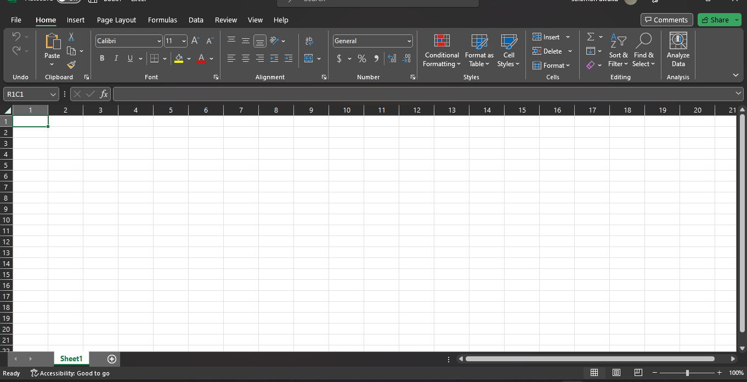
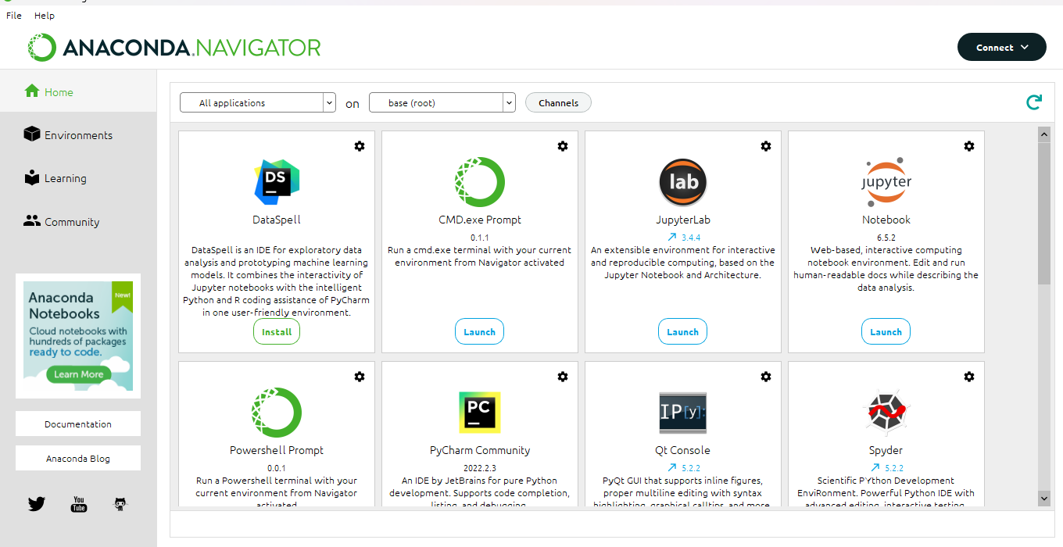
SOFTWARE
4
Software needed for this project included
Microsoft Excel
Anaconda Navigator with Spyder

Slide 5
Design and Planning
5
After performing an inventory of the software needed for the project, a plan was created for the temperature and humidity data project
To plan the design of the project, a flowchart was generated
Planning and design of the project are a crucial steps to understanding the development process

Slide 6
What is a flowchart
A flow chart illustrates the program's operating processes through basic shapes and symbols. The chart is adaptable for both experts and non-developers. And the flowchart develop illustrates the process and output of this software development project.

Slide 7
Flowchart
Start
Install python module
Download weather data to a database
Install python
Download weather data to a database.
Extract weather data from database into a comma separated file with python
Cleanse weather data
Use Excel to manipulate data
Use python data analytics modules to develop graphical models
Extract weather data from database into a CSV file
Cleanse weather data
Use Excel to manipulate data
Use python data analytics modules to develop graphical models
stop

Slide 8
8
ADDING LIBRARY
In order for python to connect to the US government National Oceanic and Atmospheric Administration (NOAA) weather data service using a cloud-based Application Programming Interface(API), a library module must be installed to use this service

Slide 9
Gathering temperature and humidity data
After planning and design, the code was developed to download a set of weather observations.
This data was stored on a local database in a table for later analysis

Slide 10
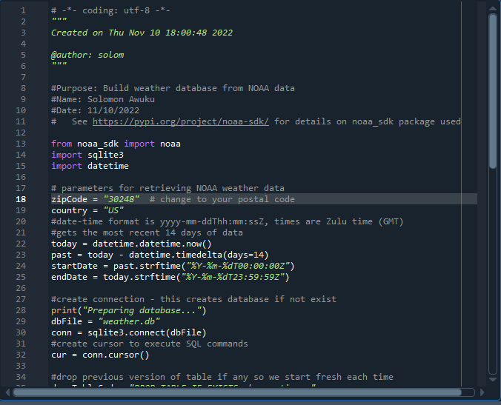
Buildweatherdb.py code (screenshot)
Screenshot of code in Spyder .
The code will create a table named observations with the fields : timestamps, windspeed, temperature, relativeHumidity, windDirection, barometricPressure,visibility and textDescription
The database will be named weather.db and stored in the same directory as the python code.

Slide 11
Weather.db database file(screenshot)

Slide 12
Querying the Database
Structured Query Language (SQL) is a programming language used for working with relational database
SQL was used to query the database and view the results

Slide 13
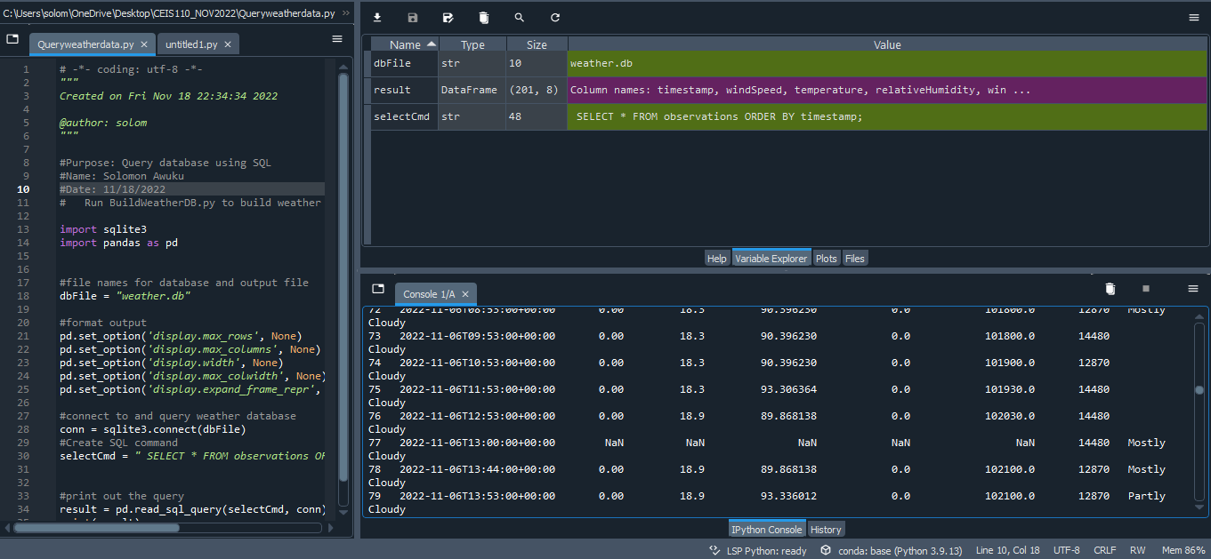
Query to retrieve all columns and all rows (screenshot)
The SQL command “select” from observation was executed to retrieve all rows and columns from the observations table

Slide 14
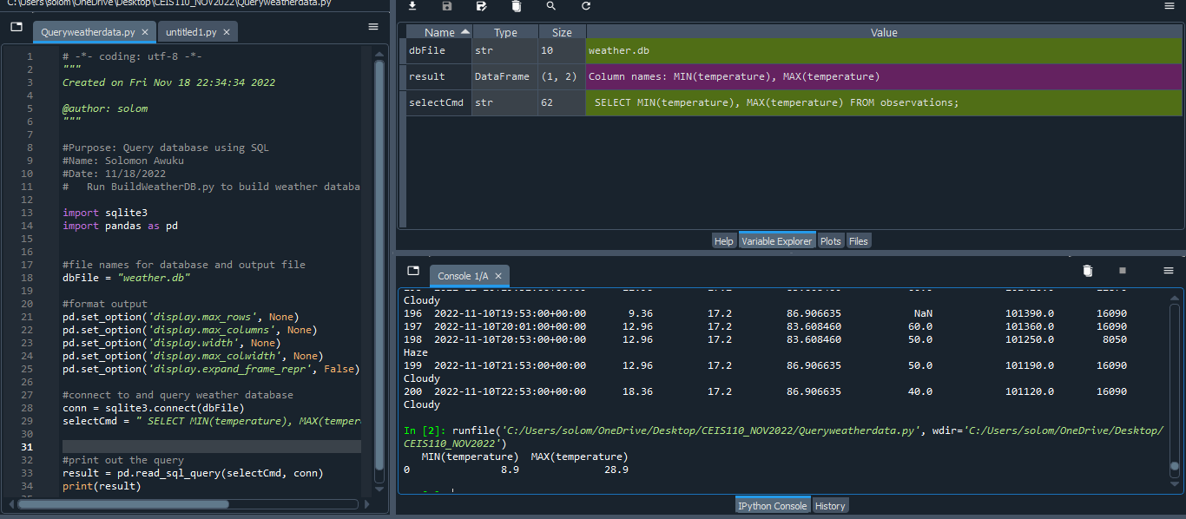
Query to retrieve lowest and highest temperature(screenshot)
The min and max temperatures were retrieved . These temperatures are captured based on Celsius scale

Slide 15
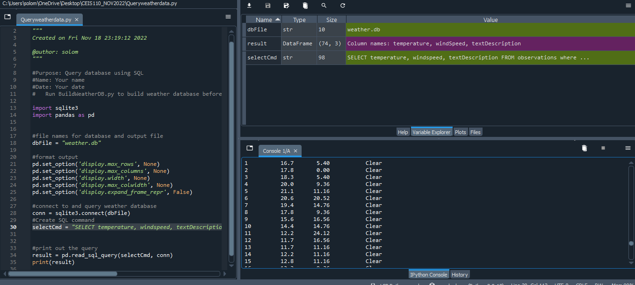
Query to retrieve the data when weather is clear (screenshot)
Another query to retrieve the temperature, windspeed ,and textdescription when weather is clear

Slide 16
Data cleansing
16
Data output from machines may have errors or extraneous data. When cleansing the data , programs can automatically put it in format needed to be read by other programs
A python program is reading in the data output by the python program and saving it in csv file so that it can be read in Excel.
Often data must be cleansed of spurious or missing values in a dataset. The data must be complete, valid and standardized .

Slide 17
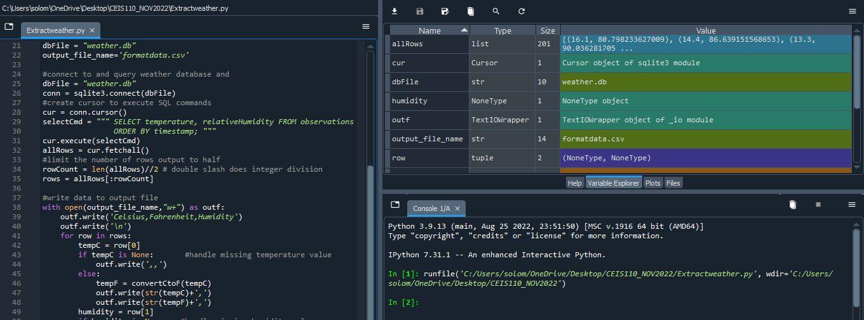
T
Extracting Temperature and Humidity using Python code
17
The weather. db. database may contain null or missing values . The code used to retrieve only the temperature and humidity values and writes them to a comma separated values in (CVS )file .

Slide 18
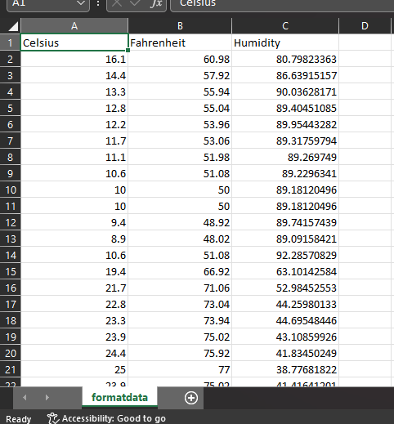
Data formatted in an excel spreadsheet
The python program created a formatdata.cvs file
This file contains 3 columns : Celsius ,Fahrenheit, and Humidity
Statistics can be done on this spreadsheet

Slide 19
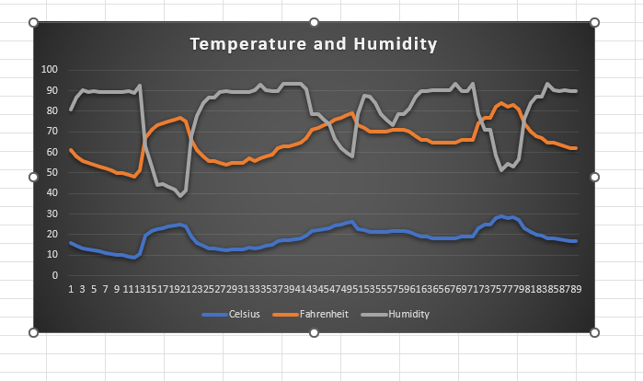
DATA Visualization
A line chart was developed in Excel showing the Temperature and Humidity .

Slide 20
Data analytics
Python Data analytics modules allows users to develop charts and graphs depicting data.
The data sets can be manipulated as well and used into tabular format
The data analytics modules are available as part of Anaconda. Several plots were generated looking at humidity and temperature
Then a prediction was made about the data

Slide 21
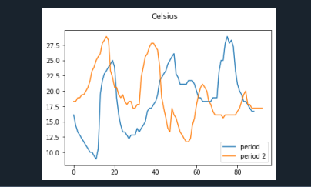
Plot command chart of Humidity
21
#Purpose: Create Celsius plot comparing period 1 and period 2
#Name: solomon Awuku
#Date: 10/02/2022
import pandas as pd
import matplotlib.pyplot as plt
df1 = pd.read_csv("formatdata.csv") #baseline data is period 1 (older)
df2 = pd.read_csv("formatdata2.csv") #data for period 2 (more recent)
plt.figure(); df1.Celsius.plot(label = 'period '); df2.Celsius.plot(label = 'period 2'); plt.legend(loc='best'); plt.suptitle('Celsius')
plt.show()

Slide 22
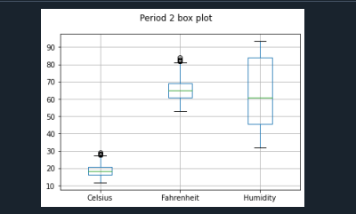
Period 2 Box Plot
22
#Name: Solomon Awuku
#Date: 11/03/2022
import pandas as pd
import matplotlib.pyplot as plt
df2 = pd.read_csv("formatdata2.csv")
df2.boxplot(); plt.suptitle('Period 2 box plot')
plt.show()

Slide 23
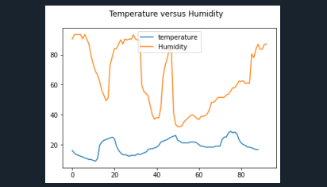
Analysis
The next step in analysis is developing a question and reviewing the data to answer the question. A chart can be used to look at the data
In both it looks like there is greater variation in humidity than in temperature

Slide 24
Code
24
#Purpose: Create Celsius plot comparing period 1 and period 2
#Name: Solomon Awuku
#Date: 11/02/2022
import pandas as pd
import matplotlib.pyplot as plt
df1 = pd.read_csv("formatdata.csv") #baseline data is period 1 (older)
df2 = pd.read_csv("formatdata2.csv") #data for period 2 (more recent)
plt.figure(); df1.Celsius.plot(label = 'period '); df2.Celsius.plot(label = 'period 2'); plt.legend(loc='best'); plt.suptitle('Celsius')
plt.show()

Slide 25
Prediction
25
Based on the data generated, it appears that there was greater variation in humidity than in temperature. Due to this, I predict that on any given day humidity will change more than temperature.
If Temperature is low humidity will be higher and vice versa
More trials should be performed- and other factors can be reviewed as well

Slide 26
challenges
26
When creating the python program, it needed to be in the same directory as weather.db
Misspelling the noaa library install
Coding in python and syntax errors

Slide 27
Career skills
27
Some Career skills are gained in this project :
Analysis – Reviewing charts and graphs to make predictions on the data
Programming with Python
Communication using flowcharts to depict plan of a project
Database development

Slide 28
Conclusion
28
This project covered the fundamental topics of programming with data by using data gathered from a cloud-based service to perform data analytics
Building this project provided a hands-on learning opportunity to put into practice the topics covered in this course

Slide 29
THANK YOU
29
Solomon Awuku
solomonawuku@gmail.com

