Slide 1
NETW211 FUNDAMENTALS FOR CLOUD COMPUTING
Solomon Awuku

Slide 2
INTRODUCTION
This project explores virtualization and cloud computing. It include hardware virtualization, cloud infrastructure, cloud security, and cloud storage. Cloud migration, capacity planning, and performance monitoring are also covered. Exploration of cloud computing platforms and services is accomplished through practical application.

Slide 3
PROJECT PREPARATON
In this project we require a cloud service provider . So, we will create an Azure account where we can deploy all our cloud recourses

Slide 4
Virtual Machine (VM) Instances
In this part of the project we will deploy, connect and delete virtual machine instances in Microsoft Azure

Slide 5
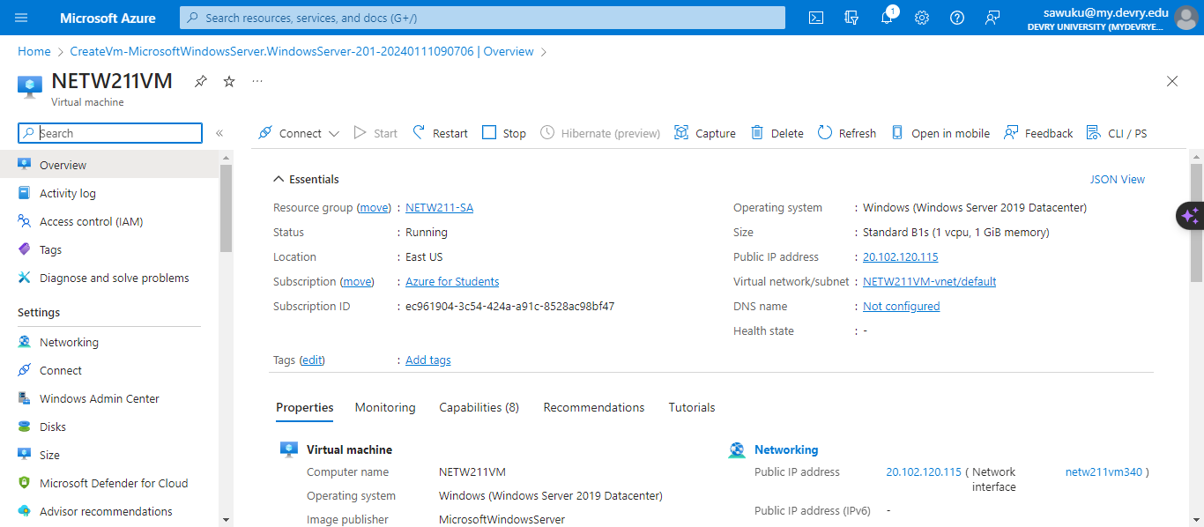
Deploying a VM in Azure

Slide 6
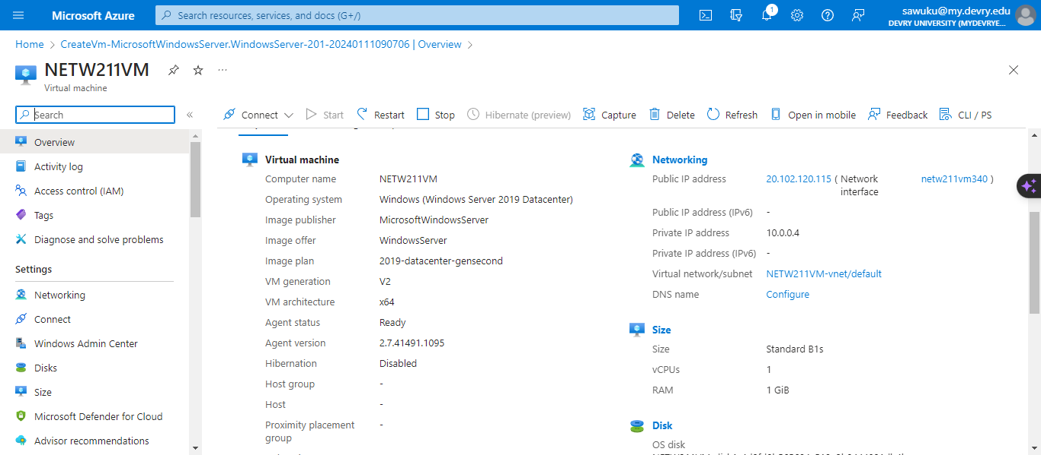
Deploying a VM in Azure

Slide 7
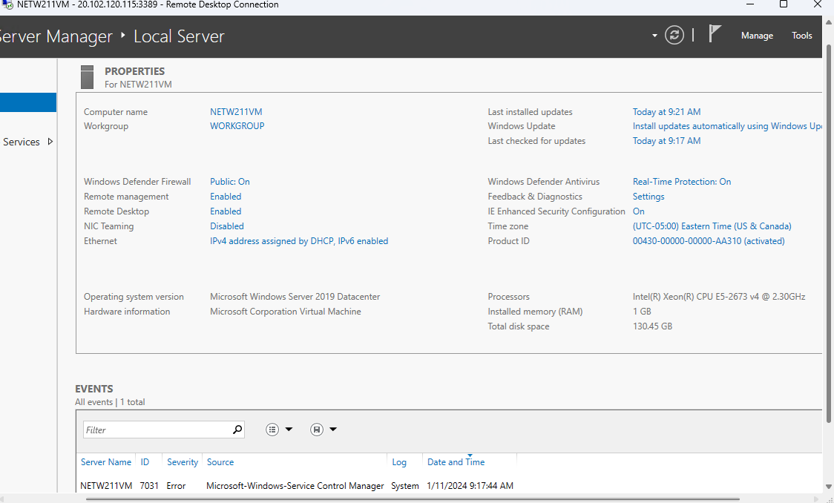
Connecting to the VM

Slide 8
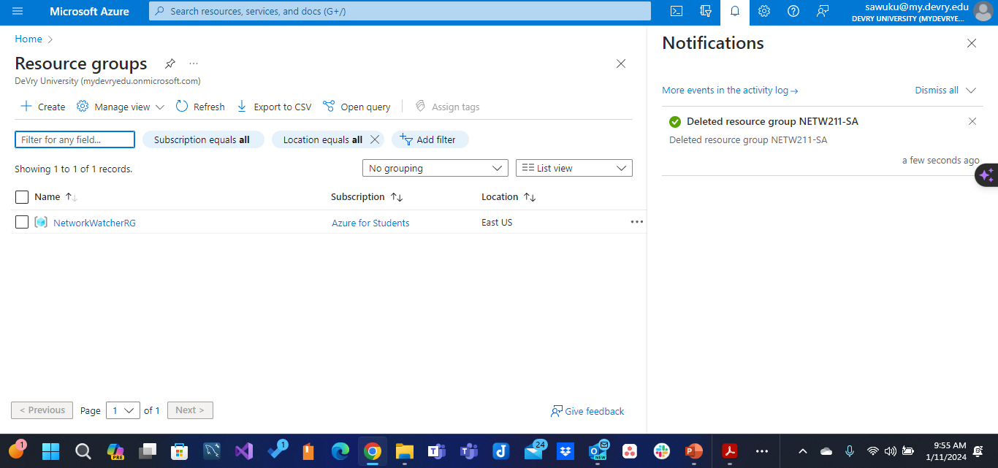
Deleting the VM

Slide 9
Azure VNet and Subnets
In this project, we will demonstrate how to create a virtual network in Azure and set up two subnets, subnet0 and subnet1. We will also deploy virtual machines within these subnets to showcase the practical implementation of a multi-subnet environment in Azure.

Slide 10
Creating a VNet with Two Subnets
1. With a /24 network prefix, how many usable IPv4 host addresses are there? [hint: you learned this in NETW191]
Answer here: 254
2. Given the answer above, why is the number of available IP addresses for Subnet0 (10.0.0.0/24) or Subnet1 (10.0.1.0/24) is 251 when you create an Azure VNet? [hint: where did the missing addresses go?]
Answer here: In Azure, when you create a Virtual Network (Vnet) with a /24 subnet, the available IP addresses are 251 instead of the typical 254. This is because Azure reserves 3 IP addresses within each subnet for its own use.
References: IP Subnet Calculator, https://www.calculator.net/ip-subnet-calculator.html
Azure Virtual Network frequently asked questions, https://docs.microsoft.com/en-us/azure/virtual-network/virtual-networks-faq

Slide 11
Deploying VMs into Subnets
(1 of 3)

Slide 12
Deploying VMs into Subnets
(2 of 3)

Slide 13
Deploying VMs into Subnets
(3 of 3)

Slide 14
Verifying Connectivity between VMs
(1 of 2)

Slide 15
Verifying Connectivity between VMs
(2 of 2)

Slide 16
Azure VM Security
In this part we will lunch a virtual machine and connect to it via ssh to configure the NSG

Slide 17
Launching a VM

Slide 18
Connecting
to the VM
via SSH

Slide 19
Configuring an NSG 1 of 2

Slide 20
Configuring an NSG 2 of 2

Slide 21
Cloud Storage
This part of the project will explore the different types of cloud storage as we upload and access file, creating Blob snapshots
and enabling Blob Versioning

Slide 22
Uploading and Accessing a File

Slide 23
Creating Blob Snapshots 1 of 2
1. What does the access tier setting do? What are the Azure blob storage access tiers?
[hint: in the Azure portal, on the Upload blob page, under Advanced, click the ? circle above the Access tier box.]
Answer here:
Azure Blob storage access tiers allow you to store blob data in different access tiers based on how frequently the data is accessed. There are four access tiers in Azure blob storage.
Hot access tier :The hot access tier is optimized for storing data that is accessed frequently. It has higher storage costs but lower access costs, making it suitable for data that needs to be accessed regularly.
Cool access tier: The cool access tier is designed for data that is accessed less frequently, but still requires fast access when needed. It has lower storage costs compared to the hot access tier but slightly higher access costs. Should be stored for a minimum of 30 days
. The cold tier has lower storage costs and higher access costs compared to the cool tier.

Slide 24
Archive access tier: The archive access tier is intended for data that is rarely accessed and can tolerate higher access latencies. It has the lowest storage costs but higher access costs and is ideal for long-term retention of data that is unlikely to be accessed frequently. Should be stored for a minimum of 180 days
Cold access tier: Data in the cold tier should be stored for a minimum of 90 days.

Slide 25
Creating Blob Snapshots
2 of 2

Slide 26
Enabling Blob Versioning

Slide 28
Cloud Monitoring
In this part we will be monitoring the cloud virtual machine by setting up an action group and notifications, Setting up alert rules and testing the alerts

Slide 29
Setting up an Action Group and Notifications

Slide 30
Setting up Alert Rules

Slide 31
Testing Alerts1 of 2

Slide 32
Testing Alerts 2 of 2

Slide 33
Challenge
Cost Management: While cloud computing can be cost-effective, it can also lead to unexpected expenses if not managed properly. Organizations need to monitor their usage and optimize their cloud resources to avoid cost overruns.
Performance: Cloud services may experience latency or performance issues due to network connectivity, server load, or other factors. This can affect the user experience and the efficiency of cloud-based applications.
Reliability and Downtime: While cloud providers typically offer high availability, there can still be instances of downtime due to technical issues, maintenance, or outages. This can impact business operations and productivity.
Network Dependency: Cloud computing relies heavily on internet connectivity. Poor network performance or outages can severely impact access to cloud services and applications.

Slide 34
Skills Acquired
Virtualization: Understanding virtualization technologies that underpin cloud services, such as virtual machines and containers.
Networking: Acquiring knowledge of cloud networking concepts, including virtual private clouds (VPCs), content delivery networks (CDNs), and network security groups.
Security: Learning about cloud security best practices, including identity and access management (IAM), encryption, and compliance with industry regulations.
DevOps: Gaining skills in DevOps practices such as continuous integration and continuous deployment (CI/CD), infrastructure as code (IaC), and automation tools like Ansible, Terraform, and Jenkins.
Data Management: Understanding how to store, manage, and analyze data in the cloud using services like databases, data lakes, and big data analytics platforms.
Monitoring and Management: Learning how to monitor and manage cloud resources and applications using tools like AWS CloudWatch, Azure Monitor, or Google Cloud Operations Suite.

Slide 35
Conclusion
This project offers a dual advantage of skill development and career advancement. It provides a deep dive into cloud technologies, equipping you with the knowledge to design, implement, and manage cloud solutions effectively. You'll gain practical skills in areas such as virtualization, networking, and security, which are essential for deploying and maintaining cloud infrastructures. The hands-on experience gained through labs and projects further enhances your ability to apply theoretical concepts in real-world scenarios, making you proficient in cloud computing.

Slide 36
Resources
https://portal.azure.com/#@mydevryedu.onmicrosoft.com/resource/subscriptions/ec961904-3c54-424a-a91c-8528ac98bf47/resourceGroups/NETW211-RG-SA6423/providers/Microsoft.Compute/virtualMachines/NETW211-VM-SA/overview
https://portal.azure.com/#home
DeVry NETW211(2024) Live session week2-week6 https://devry.engageli.com/devry/current/?R=NETW211%2812f05%29&username=solomonawuku%40gmail.com
CompTIA Cloud+ Guide to Cloud Computing

Slide 37
Thank You
By Solomon Awuku

